Slide 1
Recap and Python skills
If else elsif

Slide 2
Selection, sequence and iteration
Discuss

Slide 3
previously
Variables
Data types
Int, float and string - casting
If, elif (else if), else

Slide 4
Logical operators
These are the most common:
Not
And
Or
% (mod)

Slide 5
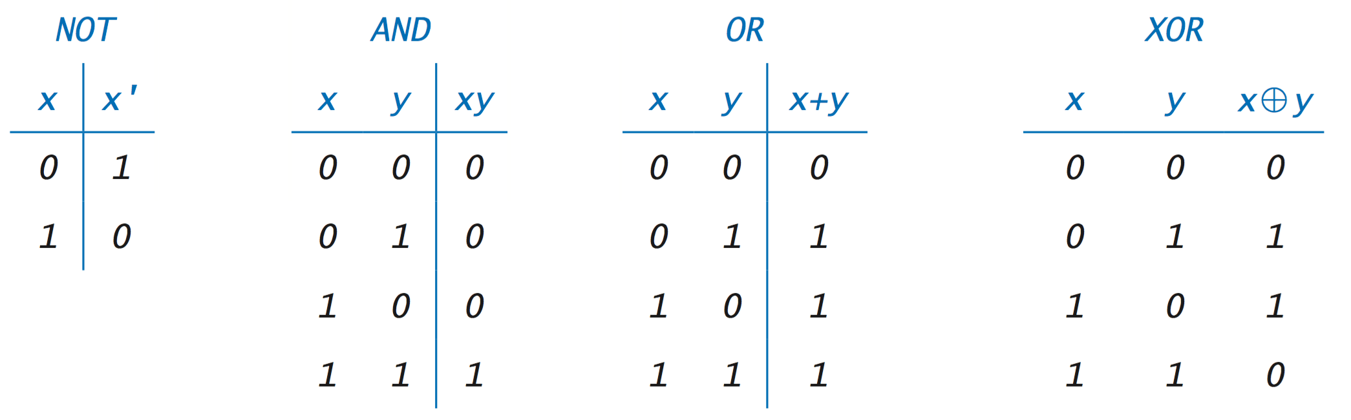
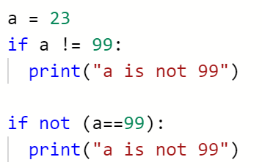
Truth table

Slide 6
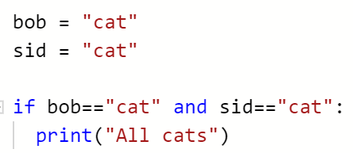
Truth table

Slide 7
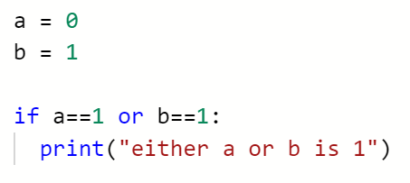
Truth table

Slide 8
today
This lesson we will pause and recap the programming concepts that we have covered so far, you will also have time this lesson to build up your Python programming skills.
Make sure you are happy with Boolean logic:
https://www.electronics-tutorials.ws/boolean/bool_7.html

Slide 9
Exam at end of year
Computer program
Variable
Data type
Comment
Whitespace
Indentation
Program sequence
Selection (branching)
If statement
If – else statement
If – elif – else statement
Create a table with three columns, Key Word, Notes, Description
Key Word | Notes | Description
Comment | # “”” comments “”” X = 1 # this does something | Style Guide for Python: Block, docstring, inline

Slide 10

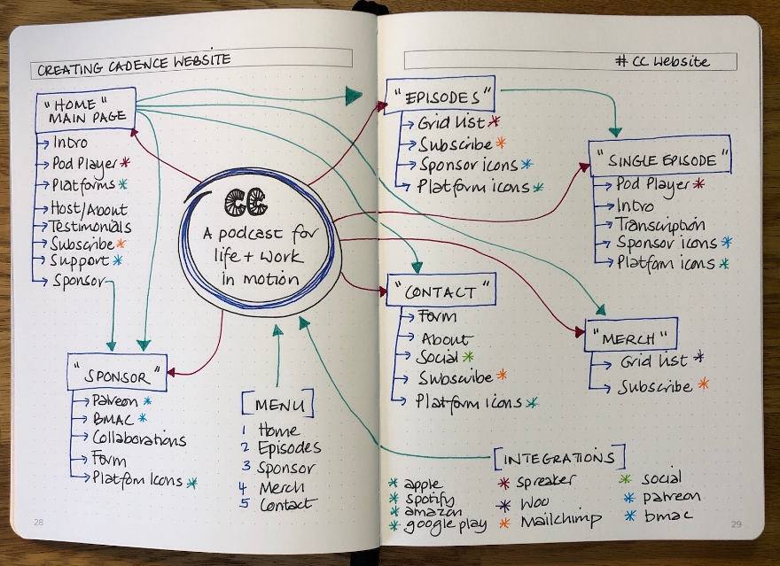
Exam – how will you revise?
Panic is a normal feeling.
Panic mitigation is a good idea.
One-to-ones with you and your notebooks.

